Slide 1
Welcome

Slide 2
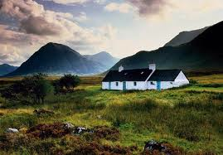
Programme for today
Checking homework
Grammar: “conditionals”
Homework
English class today

Slide 3
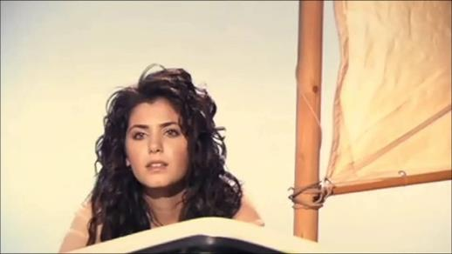
Check out this song:
Fill in the blanks
Find a pattern?
Conditionals!

Slide 4
Grammar: zero conditional
Both If and when mean ‘als’
If there is a condition that might happen, then the result is in the second sentence.
If there is a fire, we dial 112
When: - It is certain it is going to happen.
- ‘als’ means in this case ‘wanneer’, ‘zodra’, ‘op het moment dat’
When your brother comes home, we play football
C
R

Slide 5

Grammar: zero conditional
If something definitly will happen when the condition occures
Form :
If/when + present simple, + present simple
If there is a fire, we call 999
When your brother comes home, we play football
C
R

Slide 6

Grammar: first conditionals
If something didn’t happen yet, but you think it will still happen.
Form :
If + present simple + + infinitive
If I study hard, I will pass my exams.
will
C
R

Slide 7

Grammar: second conditional
If something didn’t happen, but could still happen in the future.
Form :
If + past simple + + infinitive
If I studied harder, I would pass my exams.
I-S/H/IT: were in stead of was
If I were rich, I would treat everyone.
Would
Could
Might
C
R

Slide 8
Grammar: conditionals overview
 |  | ( condition) |  | ( result )
Zero (100%) | If | Present simple |  | Present simple
First ( 80% ) | If | Present simple | will | Infinitive
 | --- | --------------------- | ---------------------- | ----------------------
Second (30% ) | If | Past simple | would could might | Infinitive

Slide 9

Homework
English Hilfe 2011
English Hilfe 2025
Conditional sentences, type I, statements - Exercise (englisch-hilfen.de)
Conditional sentences, type II, statements, Exercise (englisch-hilfen.de)

